Slide 1

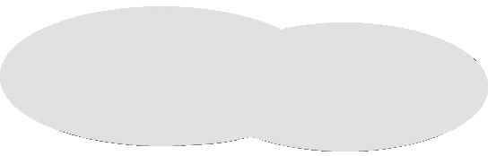


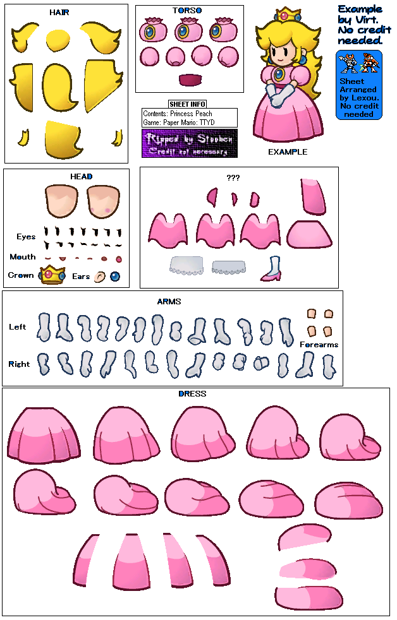
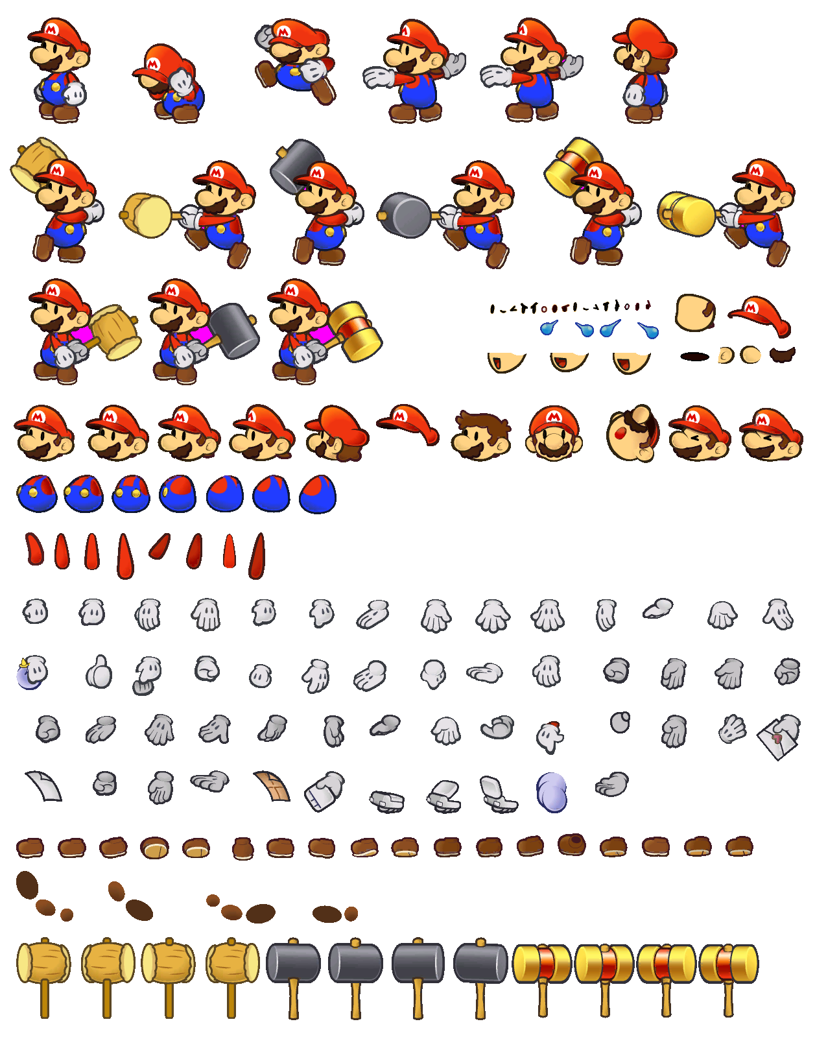

Breaking into my castle again, aren't you?
Mario!
As much as I would like to stomp you myself,
I'm busy here.
How about I send you on a trip?!
A one-way trip to dimension world!
Gamebowser! Activate!

Slide 2
System activated.
Target acquired.
Begin transportation.

Slide 3
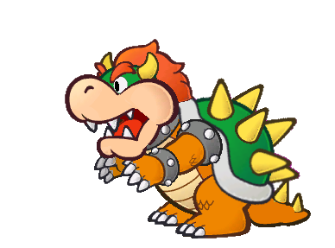
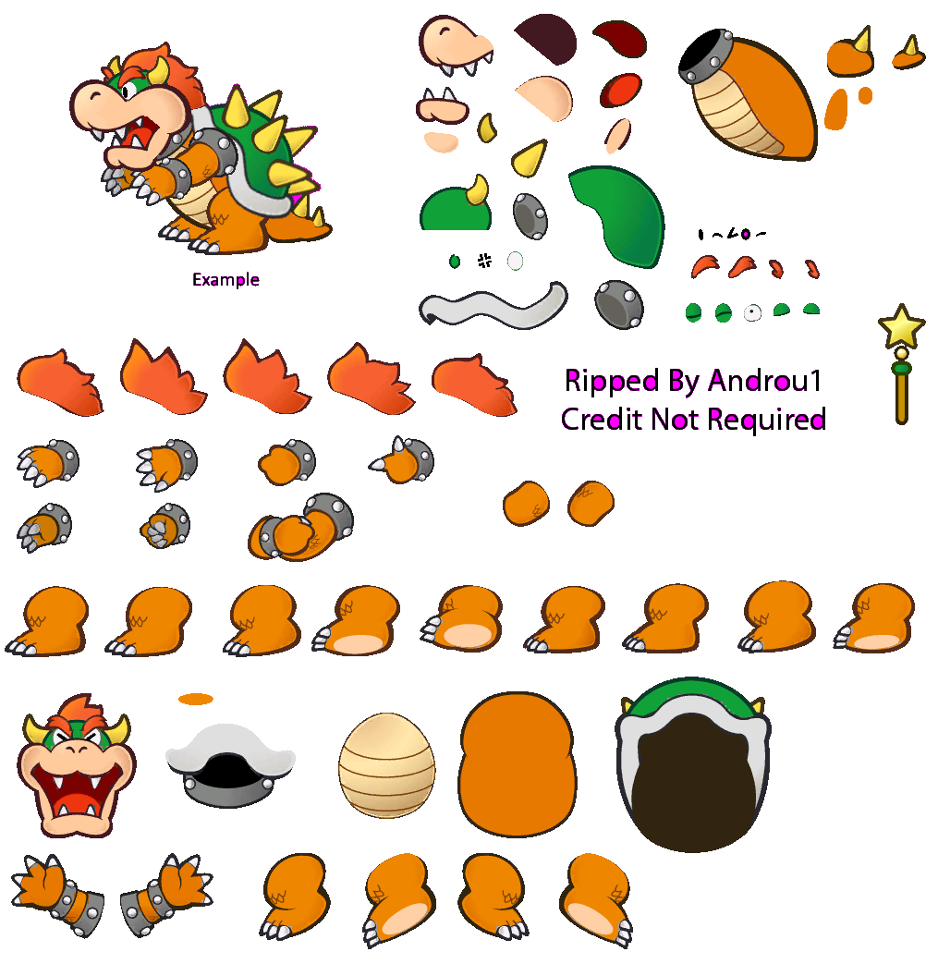
Gwah ha ha ha!
How do you feel being sucked into another world?!

Slide 4
MARIOOOOOOOOOOOO!
Transportation completed.

Slide 5
RAWWRRG...
Now I know why you're my archnemesis.
Never mind I will just stomp you to bits myself-

Slide 6
Error. Target escaped. Self destruct in 3..
2..
Uh-oh

Slide 7

GAAAAHHHHHH

Slide 8
Thank you for coming to save me, Mario.
Now shall we go back to mushroom kingdom?

Slide 9


